Slide 1
4DB001 - Database
Week-01, Lecture-01

Slide 2
Module Overview
This module will provide you with a firm grounding in the principles of Professional Databases. The topics you will study include why databases are important, how to design and manipulate a DBMS. This will involve you looking at database design techniques; different models of data and gain a firm understanding of the challenges of working with a multi-user database user environment.
The module will give you practical experience of using SQL within a modern relational database management system.

Slide 3
Module Delivery
Lecture:
Lecture will provide proper theoretical explanation of any content planned for that week.
Attendance is mandatory and will be monitored.
Workshops:
Doubt Clearing
Practical implementation of that week with codes.

Slide 4
Who am I?
Anmol Adhikari
Module Leader
MSc. IT Data Analytics - London Metropolitan University
BSc. (Hons.) IT Computing - London Metropolitan University
Work Related Description:
Lecturer, Herald College Kathmandu
FYP Reader, Herald College Kathmandu
Content Writer, Analytics Vidya
Former Head of Information Technology, Surya Print Pvt. Ltd.
Former IT Consultant, Surya Chemicals Pvt. Ltd.
Former Developer, Bhagawati Enterprises
Former Project Manager, BlueBell Software Solution
Practical Research:
Machine learning technique for intrusion detection in the field of the intrusion detection system
Theoretical Research:
Creating and Managing Project Folder Structure for Final Year Project
Understanding SQL Data Analytics(Part 1)
Hand-written Digit Recognition Using CNN classification
Twitter Sentimental Analysis Using Naive Bayes Classifier

Slide 5
Module Team
Adarsha Khadka
Instructor
MSc. IT Data Analytics – London Metropolitan University
Bachelors in Computer Information System (BCIS) - Pokhara University
Work Related Description:
Assistant Lecturer, Herald College Kathmandu
Senior Software Engineer, Code Vatika Pvt. Ltd
Former Senior Laravel Developer - Voyage De Himalayans
Former Junior Laravel Developer - Digihawk
Former Quality Assurance(QA) - Sambridhi Capital
Former Intership as Developer - Digihawak Pvt. Ltd
Projects:
BHCC Management System
Birgunj Public College Website
Snap and Go
Zen travels and Tours
Voygae De Himalayans

Slide 6
Module Team
Sujan Aryal
Instructor
MSc. IT Data Analytics – London Metropolitan University
Bsc Hons Computing - Leeds Beckett University
Work Related Description:
Assistant Lecturer, Herald College Kathmandu
Senior Software Engineer/Designer - Code Vatika Pvt. Ltd
Former Senior Content Developer - Study Info Center
Senior Laravel Developer - Smash Trip Pvt. Ltd
Web Developer - Zegal Nepal
Practical Research:
Sign Language Detection and text formation using ML/DL
Object Detection and Human object Interaction using Ml/DL
Projects:
BHCC Management System
Snap and Go
Easy Trends
Tathastu
Career Safari

Slide 7
Module Logistics
SN. | Assignments | Points | Submission Deadlines
1. | Class Test | 5 | Week 5
2. | Coursework | 45 | Week 8

Slide 8

Email Etiquette
Email from your college account only .
Always include your student number, and the module you are referring to (code and title).
Be polite, formal and use a spellchecker.
Do not email the same thing twice if we fail to respond within 10 minutes!
Kindly, mail you respected instructor if any queries and CC Anmol.Adhikari@heraldcollege.edu.np

Slide 9


Ground Rules
Our expectations
Please switch your cell phones to off/silent.
Attendance will be monitored please email me if you are unable to attend.
Be on time or don’t bother.
Pen and paper for Lectures.
Laptops required during workshops.

Slide 10
Introduction to Database System Architecture
Anmol Adhikari

Slide 11

What’s in it for you?
Introduction of DBMS
Applications of DBMS
Advantages of DBMS
Three levels ANSI SPARC database system
Data Abstraction in DBMS
Mappings and data independence
Database users and DBA
Database system architecture

Slide 12
1. What is Database Management System (DBMS)?
Data - Fact that can be recorded or stored
e.g. Person Name, Age, Gender and Weight etc.
Database - Collection of logically related data
e.g. Books Database in Library, Student Database in University etc.
Management - Manipulation, Searching and Security of data
e.g. Viewing result in EVISION website, Searching exam papers in LMU website etc.
System - Programs or tools used to manage database
e.g. SQL Server Studio Express, Oracle etc.
DBMS - A Database Management System is a software for creating and managing databases.
Database Management System (DBMS) is a software designed to define, manipulate, retrieve and manage data in a database.
e.g. MS SQL Server, Oracle, My SQL, SQLite, MongoDB etc.

Slide 13
2. Applications of DBMS
DBMS is a computerized record-keeping system.
DBMS is required where ever data need to be stored.
E-Commerce (Flikart, Amazon, Shopclues, eBay etc...)
Online Television Streaming (Hotstar, Amazon Prime etc...)
Social Media (WhatsApp, Facebook, Twitter, LinkedIn etc...)
Banking & Insurance
Airline & Railway
Universities and Colleges/Schools
Library Management System
Human Resource Department
Hospitals and Medical Stores
Government Organizations

Slide 14

2.1. Reduce data redundancy (duplication)
Computer
Civil
Emp_Name | Address | Mobile | Subject
Emp_Name | Address | Mobile | Subject
Prof. Bal Shah | Brt | 1234 | PPS
Prof. Bal Shah | Brt | 1234 | PPS
Database management system can remove such data redundancy by storing data centrally.
Same data is stored at
four different places.
Emp_Name | Address | Mobile | Subject
Emp_Name | Address | Mobile | Subject
Prof. Bal Shah | Brt | 1234 | PPS
Prof. Bal Shah | Brt | 1234 | PPS
Electrical
Mechanical

Slide 15
2.2. Remove data inconsistency
Computer
Civil
Emp_Name | Address | Mobile | Subject
Emp_Name | Address | Mobile | Subject
6789
Prof. Bal Shah | Brt | 1234 | PPS
Prof. Bal Shah | Brt | 1234 | PPS
Database management system can keep data in consistent state.
Same data having
different state (values)
Mobile no is changed
Emp_Name | Address | Mobile | Subject
Emp_Name | Address | Mobile | Subject
6789
Prof. Bal Shah | Brt | 1234 | PPS
Prof. Bal Shah | Brt | 1234 | PPS
Electrical
Mechanical

Slide 16


2.3. Guaranteed atomicity
Sum of both account before transfer is 3000
Person A
Account A
Bal : 2000
Transfer 500
Person B
Account B
Bal : 1000
Step 1 : Debit 500 from Account A
Step 2 : Credit 500 into Account B
Transaction is failed
Sum of both account is 2500
so inconsistent
Sum of both account
after transfer is 3000

Slide 17
2.4. Allow to implement integrity constraints
Emp_Name | Address | Mobile_No | Subject
Prof. Bal Shah | Brt | 9876543210 | PPS
Should contain exact 10 digits
Student_Name | Branch | Backlog | SPI
Ronit Shrestha | Brt | 0 | 8.5
Should be between 0 to 10
DBMS allows us to implement such business rules in our database..

Slide 18

2.5. Sharing of data among multiple users
Want to access
Computer
Civil
Emp_Name | Address | Mobile | Subject
Emp_Name | Address | Mobile | Subject
Prof. Bal Shah | Brt | 1234 | PPS
Prof. Bal Shah | Brt | 1234 | PPS
Want to access
Database management system allows more than one user to access same data simultaneously.
Emp_Name | Address | Mobile | Subject
Emp_Name | Address | Mobile | Subject
Prof. Bal Shah | Brt | 1234 | PPS
Prof. Bal Shah | Brt | 1234 | PPS
Electrical
Mechanical

Slide 19

2.6. Restricting unauthorized access to data
File - 1
Emp_Name | Address | Mobile | Subject
Prof. Bal Shah | Brt | 1234 | PPS
Wants to access
Faculty of other college
File - 2
Emp_Name | Post | Salary | Load
Prof. Bal Shah | Lecturer | 50,000 | 15
Wants to access
Herald Faculty
File - 3
Emp_Name | Teaching | Knowledge | Rating
Prof. Bal Shah | Good | Excellent | 9
DBMS prevents unauthorized user to access data.

Slide 20
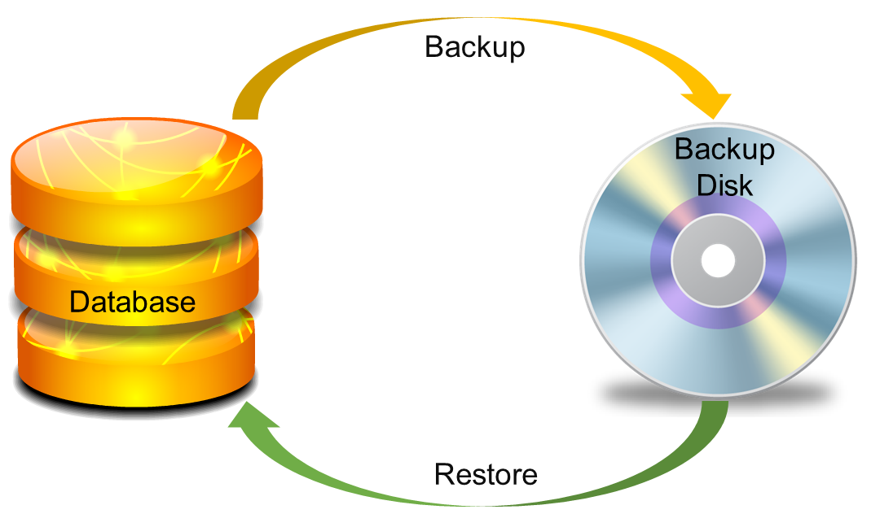
2.7. Providing backup and recovery services
Provides facilities to backup and restore the database in case of failure.

Slide 21
2.8. Advantages of DBMS (Summary)
Reduce data redundancy (duplication)
Avoids unnecessary duplication of data by storing data centrally.
Remove data inconsistency
By eliminating redundancy, data inconsistency can be removed.
Data isolation
A user can easily retrieve proper data as per his/her requirement.
Guaranteed atomicity
Either transaction executes 0% or 100%.

Slide 22
2.8. Advantages of DBMS (Summary)(cont..)
Allow implementing integrity constraints
Business rules can be implemented such as do not allow to store amount less than Rs. 0 in balance.
Sharing of data among multiple users
More than one users can access same data at the same time.
Restricting unauthorized access to data
A user can only access data which is authorized to him/her.
Providing backup and recovery services
Can take a regular auto or manual backup and use it to restore the database if it corrupts.

Slide 23
3. Basic Terms
Data
Data is raw, unorganized facts that need to be processed.
Example: Marks of students
Student_1 = 50/100, Student_2 = 25/100.
Information
When data is processed, organized, structured or presented in a given context so as to make it useful, it is called information.
Example: Result of students (Pass or Fail)
Student_1 = Pass, Student_2 = Fail.

Slide 24
3. Basic Terms(cont..)
Metadata
Metadata is data about data.
Data such as table name, column name, data type, authorized user and user access privileges for any table is called metadata for that table.
Metadata of above table is:
Table name such as Faculty
Column name such as Emp_Name, Address, Mobile_No, Subject
Datatype such as Varchar, Decimal
Access privileges such as Read, Write (Update)
Faculty
Emp_Name | Address | Mobile_No | Subject
Prof. Bal Shah | Brt | 9876543210 | PPS

Slide 25
3. Basic Terms(cont..)
Data dictionary
A data dictionary is an information repository which contains metadata.
Data warehouse
A data warehouse is an information repository which stores data.
Table Name – Faculty
Column Name – EmpName, Address, Mob, Subject, Salary
Datatype – Varchar, Decimal
Access Privileges – Read, Write (Update)
Faculty
Emp_Name | Address | Mobile_No | Subject
Prof. Bal Shah | Brt | 9876543210 | PPS
Prof. Bal Patel | Ktm | 0123456789 | DBMS

Slide 26
3. Basic Terms(cont..)
Field
A field is a character or group of characters that have a specific meaning.
E.g, the value of Emp_Name, Address, Mobile_No etc are all fields of Faculty table.
Record / Tuple
A record is a collection of logically related fields.
E.g, the collection of fields (Emp_Name, Address, Mobile_No, Subject) forms a record for the Faculty.
Faculty
Emp_Name | Address | Mobile_No | Subject
Prof. Bal Shah | Brt | 9876543210 | PPS
Prof. Ram Patel | Ktm | 0123456789 | DBMS
Fields
Prof. Bal Shah
Brt
9876543210
Prof. Bal Shah | Brt | 9876543210 | PPS
Record / Tuple
Prof. Ram Patel | Ktm | 0123456789 | DBMS

Slide 27

4. 3 Levels ANSI SPARC Database System
American National Standards Institute, Standards Planning And Requirements Committee
User 1
User 2
User 3
How data are viewed by each users?
View 1
View 2
View 3
View
Level
What data are stored and
What relationships exist?
Conceptual
Level
Logical
Level
How the data are actually stored on storage devices?
Internal
Level
Physical
Level
Database

Slide 28
4. 3 Levels ANSI SPARC Database System
Internal level (Physical level)
It describes how a data is stored on the storage device.
Deals with physical storage of data.
Structure of records on disk - files, pages, blocks and indexes and ordering of records
Internal view is described by the internal schema.
Conceptual level (Logical level)
What data are stored and what relationships exist among those data?
It hides low level complexities of physical storage.
For Example, STUDENT database may contain STUDENT and COURSE tables which will be visible to users, but users are unaware about their storage.
Database administrator works at this level to determine what data to keep in the database.
External level (View level)
It describes only part of the entire database that an end user concern or how data are viewed by each user.
Different user needs different views of the database, so there can be many views in a view level abstraction of the database. Used by end users and application programmers.
End users need to access only part of the database rather than the entire database.

Slide 29
4. 3 Levels ANSI SPARC Database System: Example
We are storing student information in a student table.
User 1
User 2
User 3
User just interact with system with the help of GUI.
Users are not aware of how and what the data is stored.
View 1
View 2
View 3
View
Level
Records can be described as fields and attributes along with their data types, their relationship among each other can be logically implemented.
Programmers generally work at this level.
Conceptual
Level
Logical
Level
Records can be described as blocks of storage (bytes, gigabytes, terabytes etc.) in memory.
These details are often hidden from the programmers.
Internal
Level
Physical
Level
Database

Slide 30
5. Data Abstraction in DBMS
Database systems are made-up of complex data structures.
To ease the user interaction with database, the developers hide internal irrelevant details from users.
This process of hiding irrelevant details from user is called data abstraction.

Slide 31
6. Mapping and Data Independence
Want to access some data
User 1
User 2
User 3
View 1
View 2
View 3
View
Level
Request
Process of transforming requests and results between the three levels is called mapping.
Conceptual
Level
Logical
Level
Ability to modify a schema definition in one level without affecting a schema definition in the next higher level.
Internal
Level
Physical
Level
Result
Database

Slide 32
7. Types of Data Independence
Physical Data Independence
Physical Data Independence is the ability to modify the physical schema without requiring any change in logical (conceptual) schema and application programs.
Modifications at the internal levels are occasionally necessary to improve performance.
Possible modifications at internal levels are changes in file structures, compression techniques, hashing algorithms, storage devices, etc.
Logical Data Independence
Logical data independence is the ability to modify the conceptual schema without requiring any change in application programs.
Modification at the logical levels is necessary whenever the logical structure of the database is changed.
Application programs are heavily dependent on logical structures of the data they access. So any change in logical structure also requires programs to change.

Slide 33
8. Role of DBA (Database Administrator)
Schema Definition
DBA defines the logical schema of the database.
Storage Structure and Access Method Definition
DBA decides how the data is to be represented in the database & how to access it.
Defining Security and Integrity Constraints
DBA decides on various security and integrity constraints.
Granting of Authorization for Data Access
DBA determines which user needs access to which part of the database.
Liaison with Users
DBA provide necessary data to the user.

Slide 34
8. Role of DBA (Database Administrator)(Cont..)
Assisting Application Programmer
DBA provides assistance to application programmers to develop application programs.
Monitoring Performance
DBA ensures that better performance is maintained by making a change in the physical or logical schema if required.
Backup and Recovery
DBA backing up the database on some storage devices such as DVD, CD or magnetic tape or remote servers and recover the system in case of failures, such as flood or virus attack from this backup.

Slide 35
9. Database System Architecture
Naive
user
Application programmer
Sophisticated
user
Database administrator
uses
write
uses
uses
Application
interfaces
Application
program
Query
tool
Administration tool
Translates DML statements into low level instructions that the query evaluation engine understands
Compiler and linker
DML queries
DDL interpreter
Interprets DDL statements into a set of tables containing metadata
Executes low level instructions generated by DML compiler.
Deals with execution of DDL and DML statements
Application program object code
DML compiler and organizer
Query evaluation engine
Query processor
Buffer manager
File manager
Authorization and integrity manager
Transaction manager
Manages allocation of space on disk storage
Storage manager
Fetches data from disk storage to memory for being used
Preserves atomicity and controls concurrency
Provides interface between low-level data stored and application program or queries
Checks the authority of users to access data and integrity constraints
To provide faster access to data items
Indices
Data dictionary
Disk storage
To store user data
Data
Statistical data
To store statistical information about the data
To store metadata

Slide 36

Challenge Question
List and explain the advantages of DBMS over file based system. OR Explain disadvantages of files based system.
Draw and explain 3 level architecture of DBMS.
List and explain different categories/types of database users.
List and explain different tasks/roles/functions/duties of DBA (Database Administrator).
Explain DBMS architecture with block diagram. OR Explain Database System architecture with block diagram.

Slide 37
In Workshop
Installation – MYSQL Workbench
Questions & Answers

Slide 38
At the end…….
Now you are qualified for database system architecture!
Questions?

